Slide 1




Case Study and Report
Presented by: Mrigashree Ray
This event has live translations.

Slide 2
Company Overview
Analyze & Share
Phases
Key findings
Ask
Act
Prepare
Process
Agenda

Slide 3

Company
Overview
Urška Sršen and Sando Mur founded Bellabeat, a high-tech company that manufactures health-focused smart products. Sršen used her background as an artist to develop beautifully designed technology that informs and inspires women around the world. Collecting data on activity, sleep, stress, and reproductive health has allowed Bellabeat to empower women with knowledge about their own health and habits. Since it was founded in 2013, Bellabeat has grown rapidly and quickly positioned itself as a tech-driven wellness company for women.
BACK TO AGENDA

Slide 4
ASK | PREPARE | PROCESS | ANALYZE
What are some trends in smart device usage? How could these trends apply to Bellabeat customers? How could these trends help influence Bellabeat marketing strategy? | FitBit Fitness Tracker Data (CC0: Public Domain, dataset made available through Mobius): This Kaggle data set contains personal fitness tracker from thirty fitbit users. | Check the data for errors. Choose your tools. Transform the data so you can work with it effectively. Document the cleaning process. | . Identify trends and relationships.
SHARE
Create effective data visualizations. Present your findings. Ensure your work is accessible.
ACT
. Prepare the deliverables you have been asked to create, including the high-level recommendations based on your analysis.
BACK TO AGENDA

Slide 5
Ask
Objectives
Identify the business task : Identify potential opportunities for growth and recommendations for the Bellabeat marketing strategy improvement based on trends in smart device usage.
Consider key stakeholders : The main stakeholders here are Urška Sršen, Bellabeat’s co-founder and Chief Creative Officer; Sando Mur, Mathematician and Bellabeat’s cofounder; And the rest of the Bellabeat marketing analytics team.
BACK TO AGENDA

Slide 6
Prepare
The dataset includes information about daily activity, steps, and heart rate that can be used to explore users’ habits.
These datasets were generated by respondents to a distributed survey via Amazon Mechanical Turk between 03.12.2016-05.12.2016.
However this data set might have some limitations due to small sample size and collected for a short period of time.
Available to us are 18 CSV documents. Each document represents different quantitative data tracked by Fitbit. These files are loaded in EXCEL.
BACK TO AGENDA

Slide 7
Process
I chose EXCEL to transform the data due to it’s limited size so we can work with it effectively .
Removed null values, errors. The date is wrong for all the tables, updated to correct form, sorted, filtered, extracted data and transformed accordingly needed for better analysis. So therefore cleaning and formatting is done.
BACK TO AGENDA

Slide 8
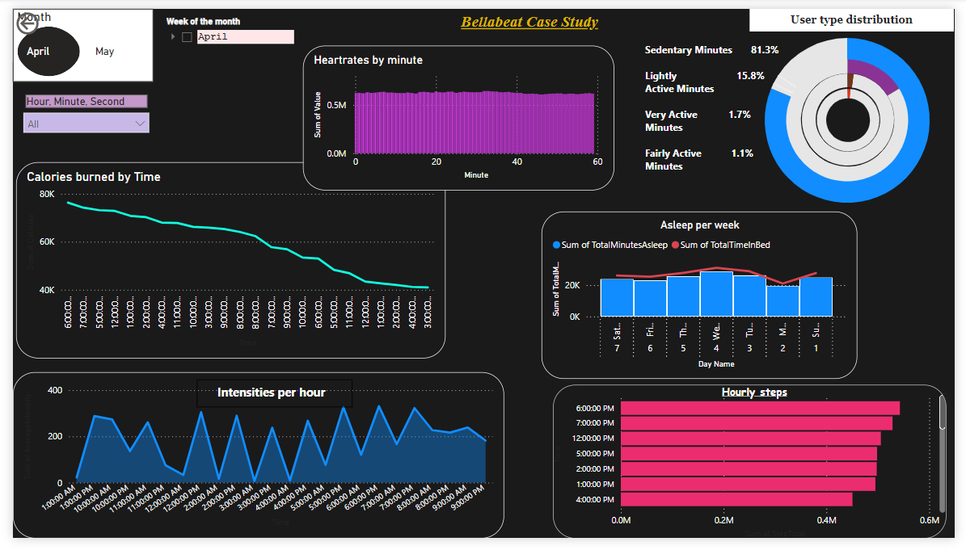
Analyze & Share
Device usage trends
BACK TO AGENDA

Slide 9
This is the dashboard made in PowerBi.
We can see trends for different dates and time using filters.
Key findings
Trends are found for heartrate, calories, steps, sleep time, usage intensities and user type distribution.
From the dashboard, we see the major part of the users are sedentary type.
The peak intensities are between the time from 5pm to 7pm.
Steps rate is highest during evening hours mostly during the hour from 6pm to 7pm, and lowers significantly later at night and during the morning hours.
The users are seen to have sleep approximately 6-7 hours which is quite healthy but the bedtime is more than the sleeptime.
Again the highest calories burned is during the evening hours.
BACK TO AGENDA

Slide 10
Act
Recommendations
To improve sleep time and reduce bedtime than the sleep time, we can send notifications to Bellabeat users.
The intensities are highest during 5-7pm, it is assumed the users are more active during those hours. So we can consider adding more features related to monitoring physical activity.
The major part of the users are seen to be sedentary and lightly active people so they are not doing enough physical activity. Sending timely reminder to take a walk or run or hit the gym to motivate hem can be done.
Also calories burned can be tracked but there is no option for calories consumed. Introduction of calorie tracker can be done and freedom to users to set their calorie limit.
Offer interchangeable, fashionable straps.
Personalize notifications according to users’ habits.
BACK TO AGENDA

